Slide 1
Accounting System Update 2011-05-15
CodeZone Pte Ltd

Slide 2
ETL: Domain Entity Objects
48 domain entity classes added
144 domain entity support classes added
192 classes created for the Extract-Transform-Load (ETL) process
ContextSwitchDeadlock exception issue resolved

Slide 3
Oracle Data warehouse Testing and Debugging: Issue Resolved
Oracle forbids table name and table fields having name length exceeding 30 characters => solved by creating camel notation name compression and data field name transformation during ETL process
Oracle don’t have auto-increment integer field, and Oracle sequence don’t auto-update when some of the auto-increment values are imported from MYOB => solved by implementing sequence generation chain
Oracle don’t allow certain keywords to be used as data field name or data table name which MYOB uses=> solved by creating a masking layer for the data field name
Oracle use a different set of datatype => solved by creating a layer of datatype translation api for database manager classes.
Oracle use different writing for SQL query statements => solved by creating abstract SQL query entity object through data provider design pattern.

Slide 4
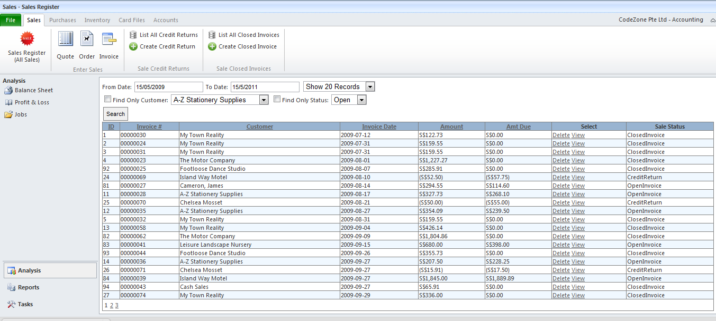
Ajax Powered ASP.NET WebSite
Ajax powered-query for column sorting, data paging, data filtering and deleting

Slide 5
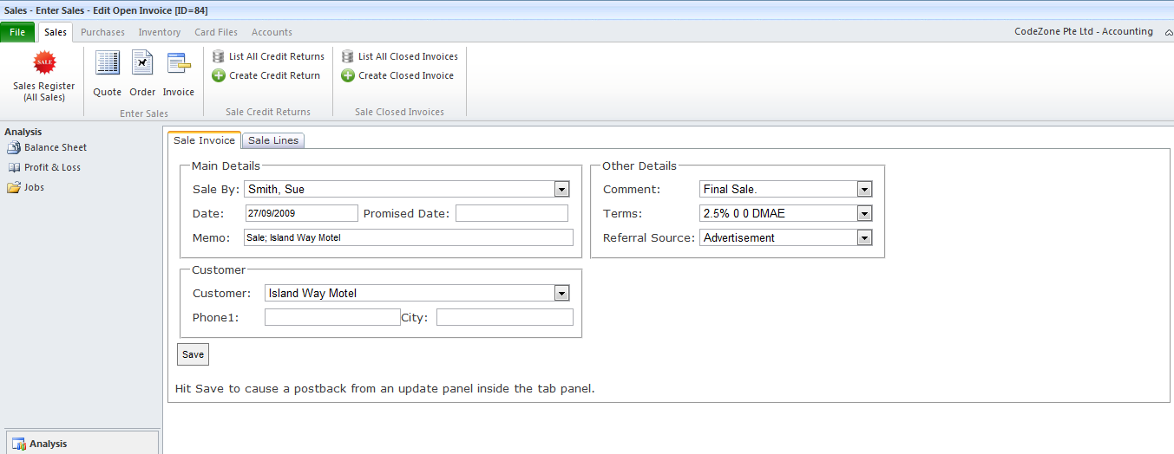
Ajax Power ASP.NET WebSite

Slide 6
LIMITATIONS of BI 2.0 Via RIA Ajax
Flaws in current ASP.NET WebForms: performance and interactivity.
jQuery and Ajax for ASP.NET are not truly RIA (rich interactive application), limited ability to develop truly web-based interactive application for the need and experience of business intelligence in typical accounting system that resembles that of desktop application
A user may want to analyze data, interact with it, and visually see it. In order to provide fast response times, application clients need to share some of the processing and caching responsibility locally.
BI 2.0 requires offload processing from a traditional “process-on-the-server” design
Propose using Silverlight or AIR

